Slide 1
Graph Theory Lab Results
Florian Speer & Nils Schröder
17.01.2025

Slide 2
Methodology
Invariant Analysis
Identify the most promising invariants (execution time vs number of clusters)
Isomorphism Analysis
Find the overall fastest invariant including the isomorphism checks
Isomorphism Scaling Analysis
Investigate the asymptotic scaling

Slide 3
Invariants
Vertex Count
Edge Count
Vertex Degrees
Rank
Edge Label Histogram
Node Label Histogram
Node Label with Edges Histogram
Edge Label with Nodes Histogram
Weisfeiler Lehman Graph Hash (1-3 Iterations)

Slide 4
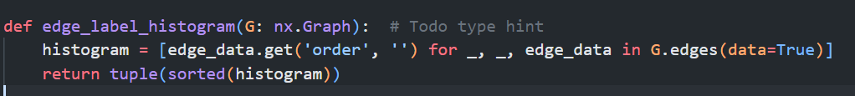
Edge label histogram

Slide 5
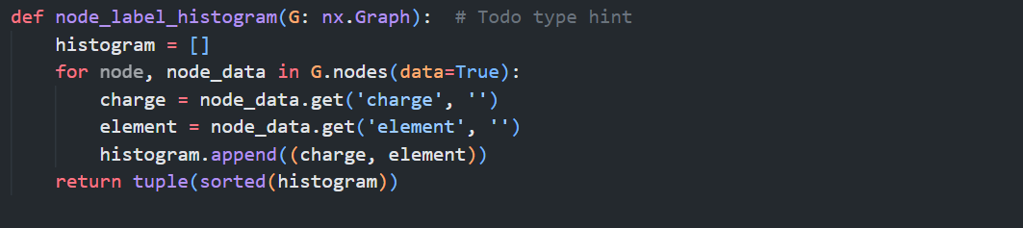
Node Label

Slide 6
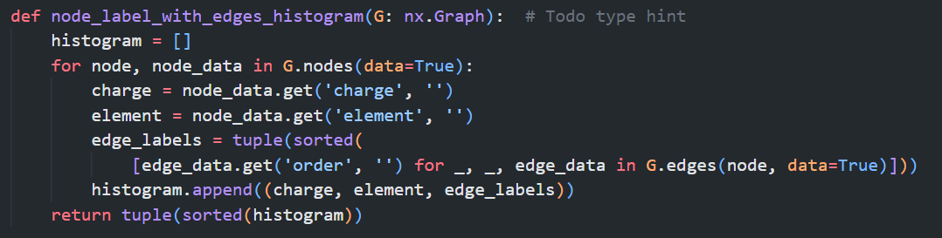
Node label with histogram

Slide 7
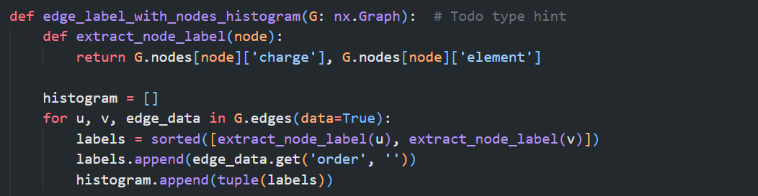
Edge label with nodes histogram

Slide 8
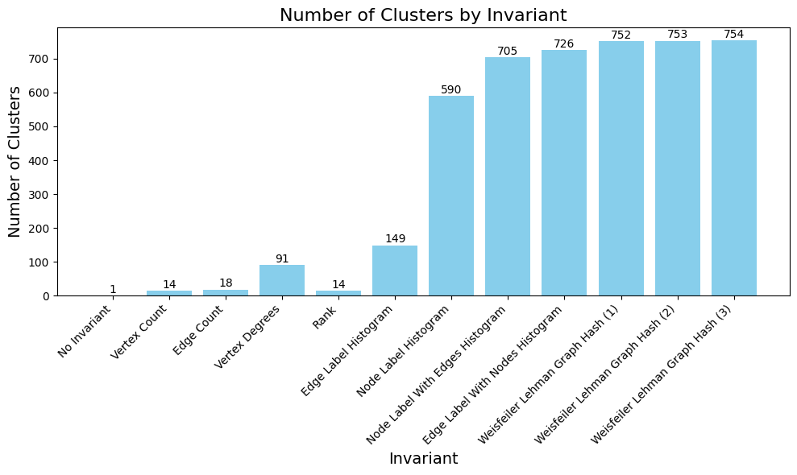
Invariant analysis
Total number of cluster = 754
Notes:
Number of cluster (bar chart sample size 1)
Execution time
Num cluster / ms
Variance (definition + bar chart)

Slide 9
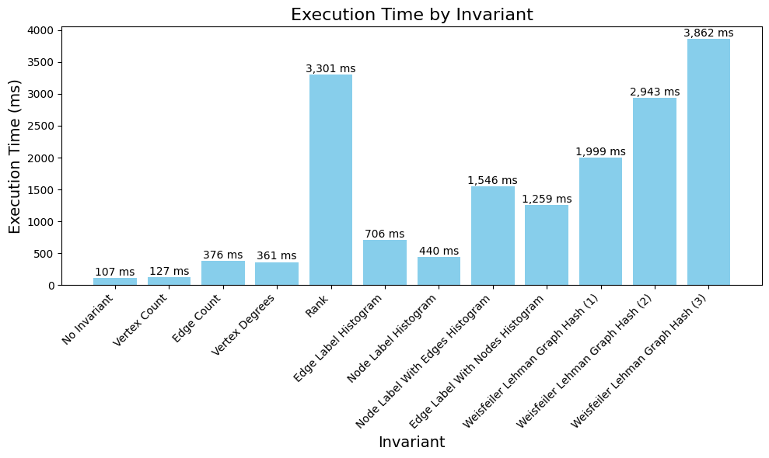
Invariant analysis
Notes:
Number of cluster (bar chart sample size 1)
Execution time
Num cluster / ms
Variance (definition + bar chart)

Slide 10
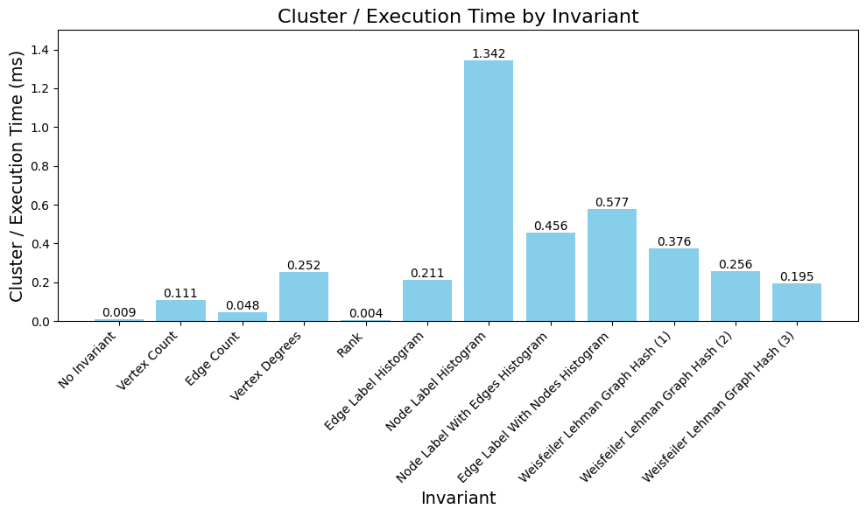
Invariant analysis
Notes:
Number of cluster (bar chart sample size 1)
Execution time
Num cluster / ms
Variance (definition + bar chart) <- 3 charts reichen glaube ich

Slide 11
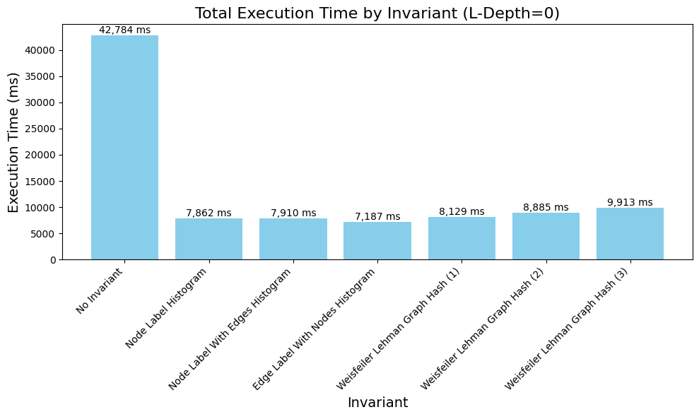
Isomorphism Analysis
Notes:
L-depth growth (execution time lineplot)
Execution time (bar chart l-depth 0)

Slide 12
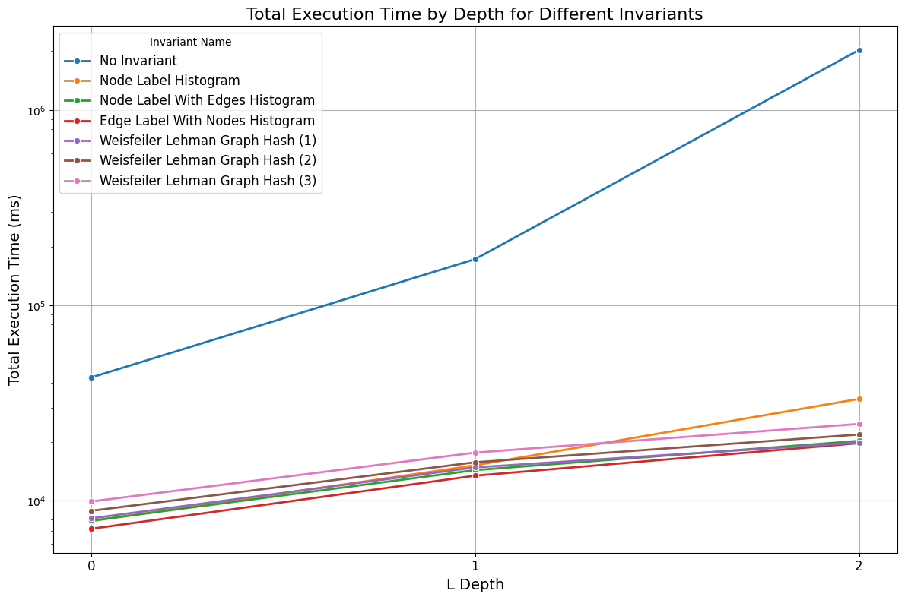
Isomorphism Analysis
speedup
> 16x
Notes:
L-depth growth (execution time lineplot)
Execution time (bar chart l-depth 0)

Slide 13
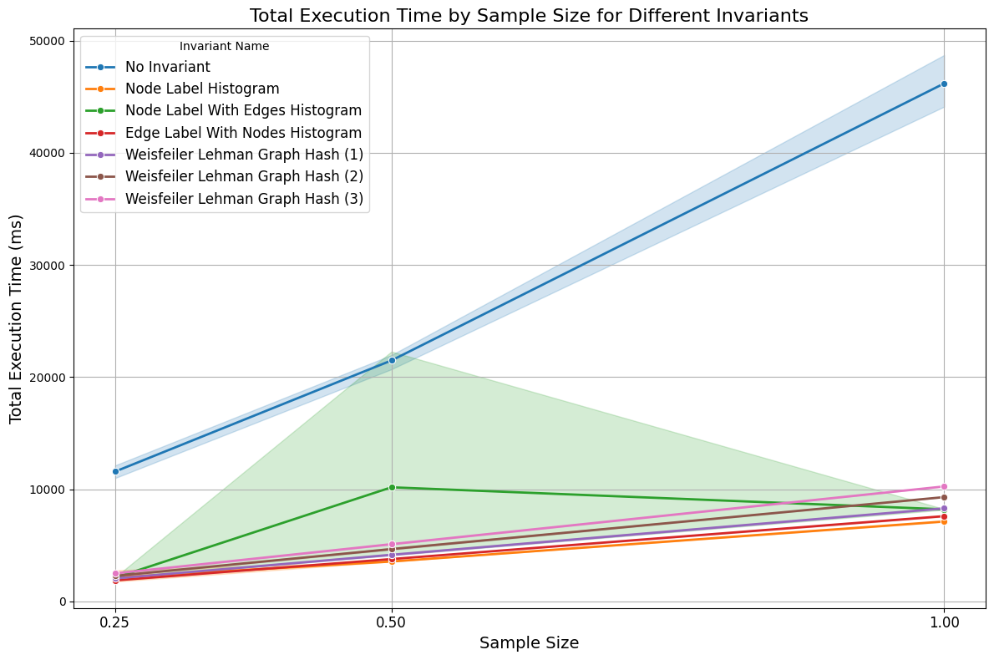
Isomorphism Scaling Analysis
L-Depth=0
Notes:
Sample size growth (execution time lineplot)
Number of checks (cluster growth)
Vs cluster growth with increasing l-depth

Slide 14
CONCLUSION
Number of clusters and number of total reactions scale differently
Label Histograms and Weisfeiler Lehmann Graph Hash are the best invariants
Linear scaling for increasing number of reactions
Exponential scaling for increasing L Depths
Edge Label with Nodes Histogram has the lowest total execution time
Node Label Histogram produces many clusters in short time
Weisfeiler Lehman Graph Hash finds with 3 Iterations all clusters for L-Depth 0-2
Notes:
Sample size growth (execution time lineplot)
Number of checks (cluster growth) <- same as time axis
Vs cluster growth with increasing l-depth

Slide 15
Vielen Dank!

